Slide 1
CS152 Section 8
Multithreading and Vectors

Slide 2
Administrivia
Lab 3 due April 5
Special discussion session on Meltdown/Spectre during week after spring break
PS4 due April 5

Slide 3
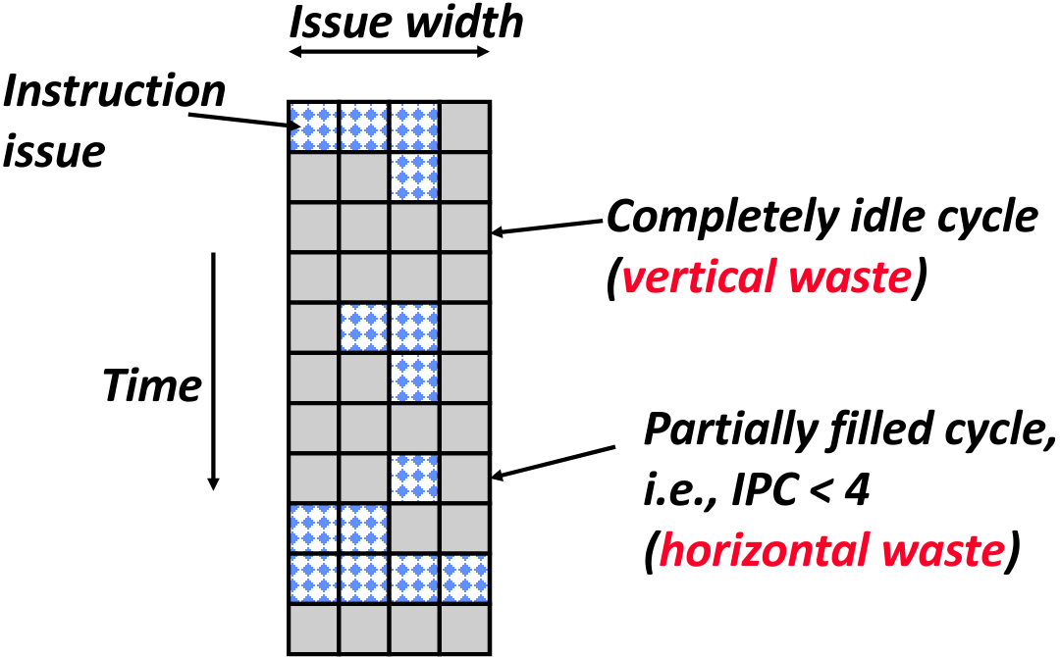
Superscalar Efficiency
Superscalar execution is limited by instruction dependencies (available parallelism) and long-latency operations in a single thread
Vertical waste: No instructions issued in a cycle
Horizontal waste: Not all issue slots filled in a cycle

Slide 4
Comparing Architectures (Q1)
 | How is vertical waste reduced? | How is horizontal waste reduced? | Limitations / disadvantages compared to an in-order superscalar RISC machine?
Out-of-Order Superscalar Execution
VLIW
Vector

Slide 5
Multithreading
Fine-grained multithreading
Switch between threads on each clock cycle
Coarse-grained multithreading
Switch threads only on costly stalls
Simultaneous multithreading
Interleave multiple threads in multiple issue slots with no restrictions

Slide 6
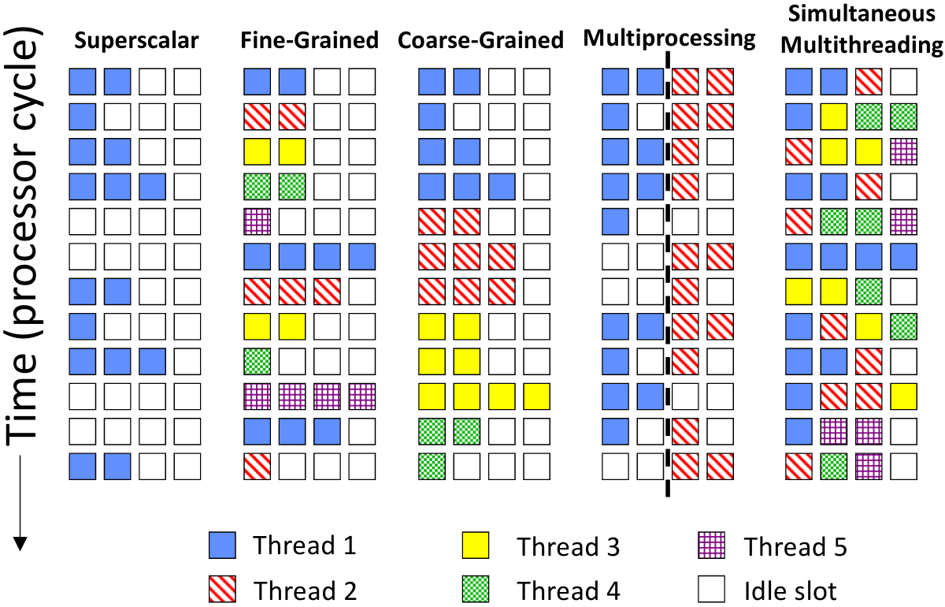
Multithreading

Slide 7
Comparing Architectures (Q1)
 | How is vertical waste reduced? | How is horizontal waste reduced? | Limitations / disadvantages compared to an in-order superscalar RISC machine?
Vertical Multithreading
Simultaneous Multithreading

Slide 8
Fine-Grained Multithreading (Q2)
In this problem, we would like to investigate the performance of the following C program on a multithreaded architecture. The arrays A, B, and C contain double-precision floating-point numbers.
for (int i = 0; i < M; i++) { C[i] = A[i] + B[i]; } | loop: fld f1, 0(x1) fld f2, 0(x2) fadd f3, f1, f2 fsd f3, 0(x3) addi x1, x1, 8 addi x2, x2, 8 addi x3, x3, 8 addi x4, x4, -1 bnez x4, loop

Slide 9
Fine-Grained Multithreading (Q2)
We rewrite the loop to split the work across N threads:
Assume:
Single-issue in-order processor
1-cycle integer operations, 3-cycle floating-point arithmetic operations, 2-cycle memory operations
Fine-grained multithreading with fixed round-robin scheduling
Perfect branch prediction.
// TID is the thread ID (0 to N-1) for (int i = TID; i < M; i += N) { C[i] = A[i] + B[i]; } | loop: fld f1, 0(x1) fld f2, 0(x2) fadd f3, f1, f2 fsd f3, 0(x3) addi x1, x1, 8N addi x2, x2, 8N addi x3, x3, 8N addi x4, x4, -1 bnez x4, loop

Slide 10
Fine-Grained Multithreading (Q2)
How many threads need to fully utilize the pipeline?
Peak performance in FLOPs/cycle?
Can peak performance be reached with fewer threads by reordering instructions in the loop?

Slide 11
Simultaneous Multithreading (Q3)
Which resources must be duplicated to support simultaneous multithreading?
Program Counter
Fetch Unit
Rename Table
Physical Register File
Issue Window
Functional Units
Reorder Buffer

Slide 12
Simultaneous Multithreading (Q3)
Icount policy prioritizes fetching from the thread with the least in-flight instructions
Why does this improve throughput?

Slide 13
Costs of Programmability
Digression: How is power spent in a general-purpose core?
Component | Dynamic Power (W) | Percentage
Clocking | 23.0 | 38.17%
System (bus interface, pins) | 3.92 | 6.51%
Fetch | 6.74 | 11.19%
FP mapper | 2.51 | 4.17%
FP issue queue | 1.5 | 2.49%
Integer mapper | 3.72 | 6.17%
Integer issue queue | 4.85 | 8.05%
Integer ALU | 2.34 | 3.88%
Integer register file | 8.48 | 14.07%
Load/store queues | 0.98 | 1.63%
Data cache | 2.21 | 3.67%
Total | 60.25
Majority of dynamic power used for control
Relatively small percentage used for compute (ALU)
Motivates more specialized accelerators for performance and energy efficiency
High-level power model based on Alpha 21264
600 MHz frequency
Calibrated for 350 nm process technology (negligible static power - not true of modern process nodes!)
Not from actual layout (so don’t take numbers too literally)
Natarajan et al., Microprocessor Pipeline Energy Analysis (2003)

Slide 14
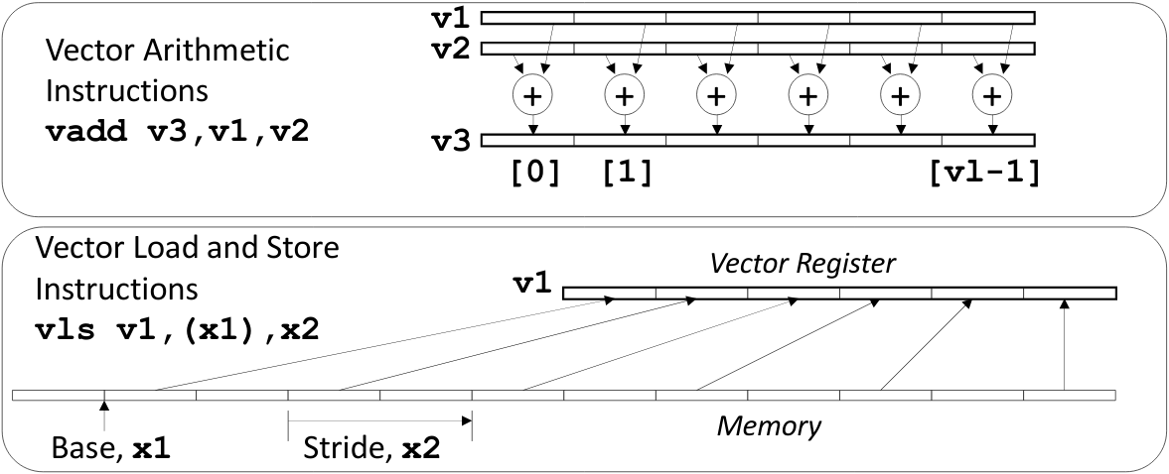
Vector Architectures
Exploits data-level parallelism (DLP)
Least flexible form of parallelism but potentially most efficient
Amortizes instruction fetch and control overhead over multiple homogeneous operations
Independent elements in a vector simplify control of deep pipelines

Slide 15
Vector Programming Model
Configurable vector lengths
Vector length (VL) control register adjusted with vsetvl instruction
Active VL can vary from 0 to hardware-specified maximum (MAXVL)
 | Scalar Code | Vector Code
for (i = 0; i < 64; i++) { C[i] = A[i] + B[i]; } | li x4, 64 loop: fld f1, 0(x1) fld f2, 0(x2) fadd f3, f1, f2 fsd f3, 0(x3) addi x1, x1, 8 addi x2, x2, 8 addi x3, x3, 8 addi x4, x4, -1 bnez x4, loop | li x4, 64 vsetvl x4 vld v1, (x1) vld v2, (x2) vadd v3, va, v2 vst v3, (x3)

Slide 16
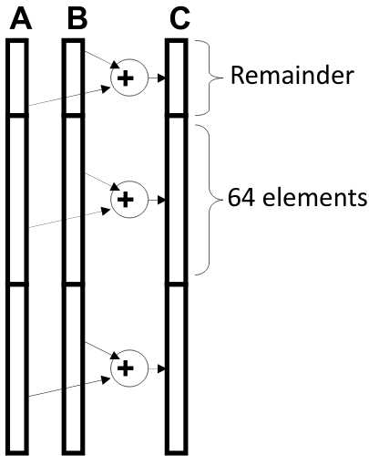
Vector Stripmining
# x4 holds N andi x5, x4, 63 # N mod 64 vsetvl x5 loop: vld v1, (x1) # Load A vld v2, (x2) # Load B vadd v3, v1, v2 # C = A + B vst v3, (x3) # Store C sub x4, x4, x5 # Subtract elements slli x5, x5, 3 # Multiply by elt size add x1, x1, x5 # Bump pointers add x2, x2, x5 add x3, x3, x5 li x5, 64 vsetvl x5 # Reset full vlen bnez x4, loop
Break loops into sections that fit into vector registers
for (i = 0; i < N; i++) { C[i] = A[i] + B[i]; }

Slide 17
Vector Stripmining
# x4 holds N loop: vsetvl x5, x4 vld v1, (x1) # Load A vld v2, (x2) # Load B vadd v3, v1, v2 # C = A + B vst v3, (x3) # Store C sub x4, x4, x5 # Subtract elements slli x5, x5, 3 # Multiply by elt size add x1, x1, x5 # Bump pointers add x2, x2, x5 add x3, x3, x5 bnez x4, loop
Alternative form of vsetvl instruction that writes the active vector length to a destination register:
vsetvl <active>, <requested>
active = min(requested, MAXVL)
Suppose MAVXL = 64:
active=64 for requested >= 64
active=requested for requested < 64
Enables vector-length agnostic programming model

